Slide 1
TOURIST MAPP
ANDROID APP PROJECT

Slide 2
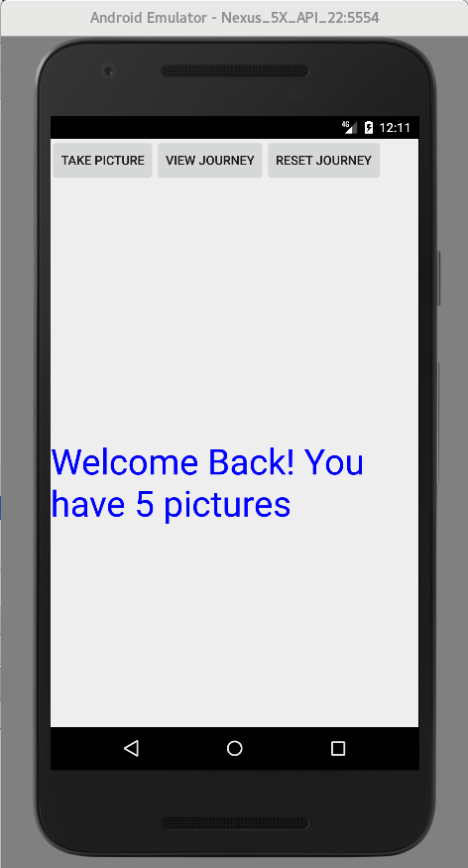
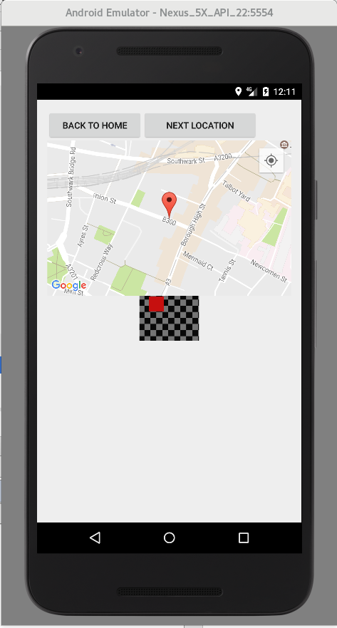
Design View 1
Design VIEW 2

Slide 3
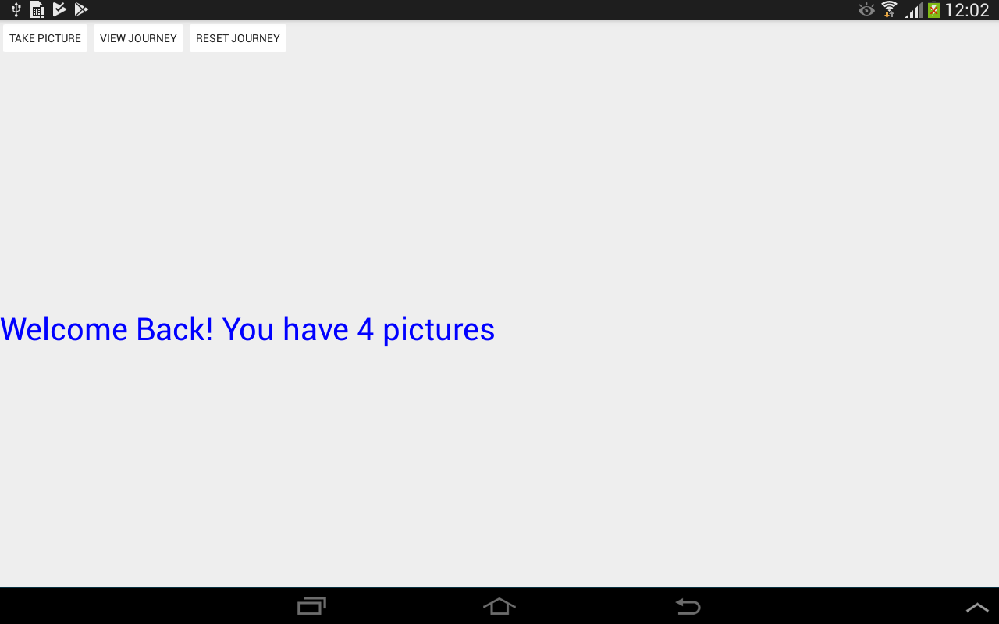
View 1 – TAKING PICTURES

Slide 4
VIEW 1 – taking pictures
https://www.youtube.com/watch?v=DP16rF-69e0

Slide 5
(ACTIVITY 1) – TAKE PHOTOS & RECORD LOCATIONS
Define application permissions:
Storage access
Vibrations
Internet
Location Services
Initialize Google Maps
Set up Shared Preferences
Create a Location Manager & Location Listener
Set up Take Picture button:
Create file paths for Images
Define intents to take photos
Store geolocations

Slide 6
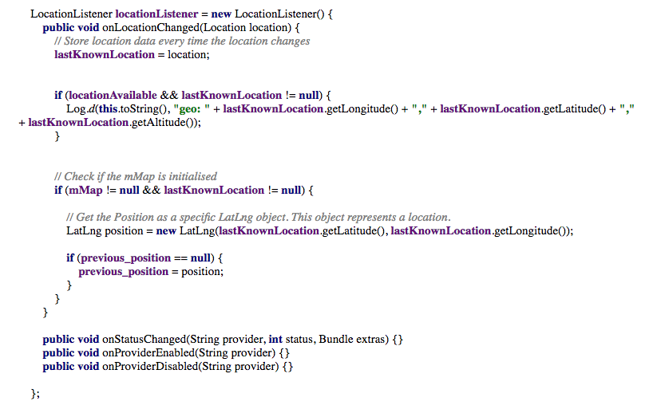
ACTIVITY 1– LOCATION LISTENER FUNCTION

Slide 7
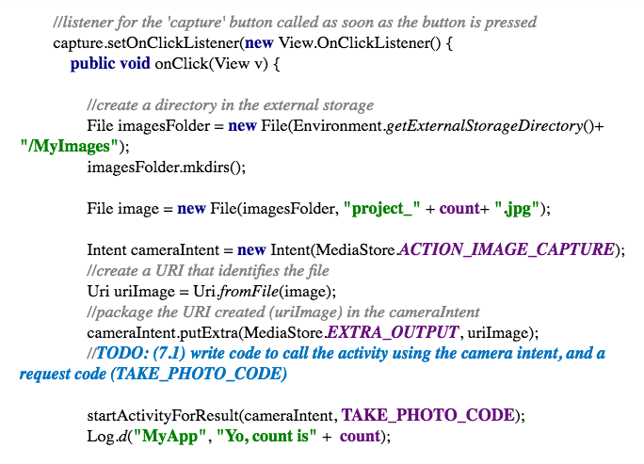
ACTIVITY 1– image capture function

Slide 8
ACTIVITY 1– image capture function

Slide 9
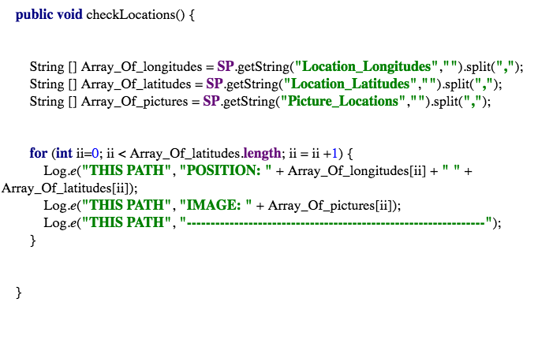
ACTIVITY 1– storing locations & images

Slide 10
View 2 – viewing journey
https://www.youtube.com/watch?v=Re2PrIqF29k

Slide 11
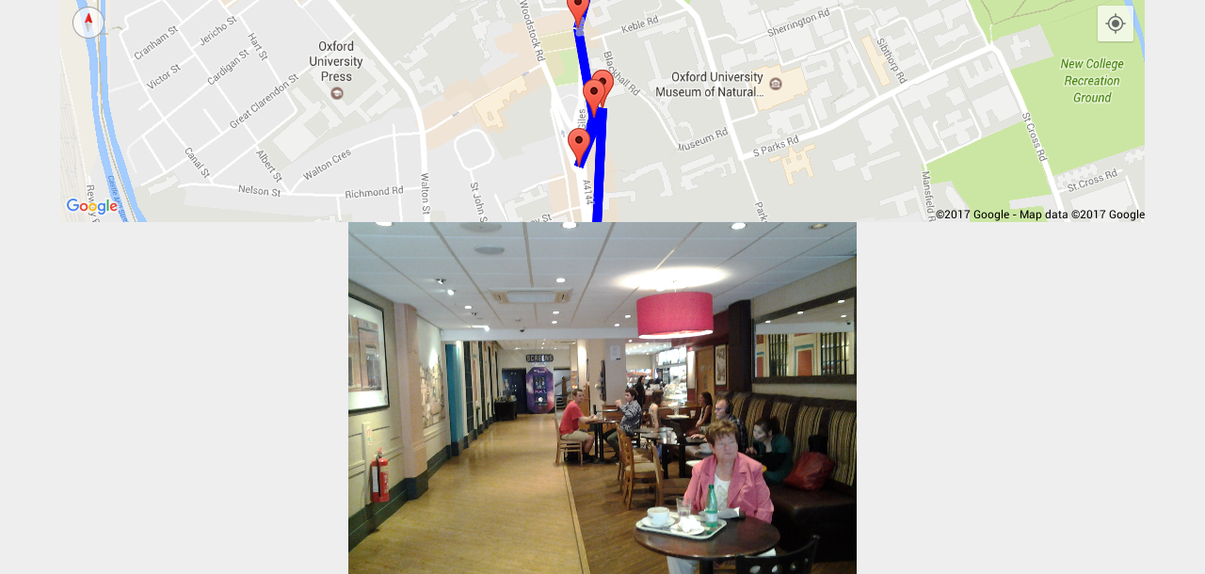
View 2 – viewing journey

Slide 12
activity 2 – viewing journey
Retrieve info from View 1 (SharedPreferences)
Retrieve image file paths & location info (stored as strings)
Convert to arrays
Set up Map View & Image View
Display markers on map for each location
Plot a line between each point.
Display the image corresponding to each marker

Slide 13

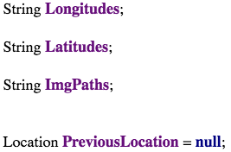
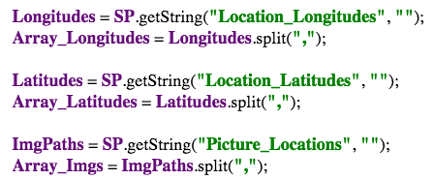
….....
PRE
DECLARED
….....
onCreate();
ACTIVITY 2– retrieving image & location info

Slide 14
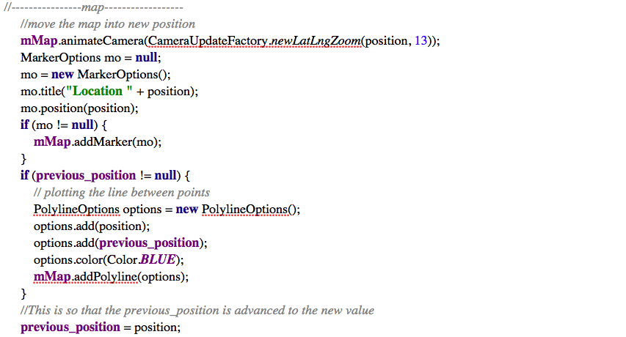
ACTIVITY 2– PLOTTING JOURNEY ON MAP

Slide 15

ACTIVITY 2– VIEWING IMAGES

Slide 16
Problems faced
COUNTER ISSUE
The counter started counting from 0.
We indexed the pictures from 1 rather than 0.
BITMAP MEMORY TOO SMALL
LOCATION ISSUE
The GPS signal was taking too long to locate the device
We used logs to identify the issue
Changed to accuracy from fine to coarse.
Set the location manager to take locations from the network provider rather than using the best provider which is the GPS.

Slide 17
IMPROVEMENTS
Allow user to save and view previous journeys.
Improve UI & UX – look and feel of app
Share journey on social media
Allow the user to plan the route in advance
App can suggest where to go
View pictures taken by other users at the same locations
Allow user to change zoom manually
Save videos as well as photos

Slide 18
demo

